Slide 1







(a) Coherent and Incoherent Alternating Structure
(b) A coherent Set (CS)
L₀
ray optics
CS:1
EM wave optics
useless
Layer 1
$$d_{1}$$
L₁
ray optics
CS:2
EM wave optics
Layer 2
$$d_{2}$$
$$……$$
ray optics
$$……$$
emitter
EM wave optics
$$d_{i}$$
$$……$$
ray optics
$$……$$
Only an ensemble of emitter is supported.
CS:n-1
EM wave optics
Layer m-1
$$d_{m−1}$$
useless
L_{n-1}
ray optics
Layer m
$$d_{m}$$
CS:n
EM wave optics
L_{n}
ray optics
z=0

Slide 2

start
Load Material/User
start
Load Structure/Structure List
$$\frac{k_{t}}{k_{o}},θ_{k_{t}}$$
Output setup (plot/write)
Calculate
$$λ$$
$$z$$
$$\frac{k_{x}}{k_{o}},\frac{k_{y}}{k_{o}}$$
Angle/XY
field z distribution (internal emission)

Slide 3
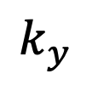



$$k_{y}$$
$$k_{t}$$
$θ_{k_{t}}$
$$k_{x}$$

Slide 4
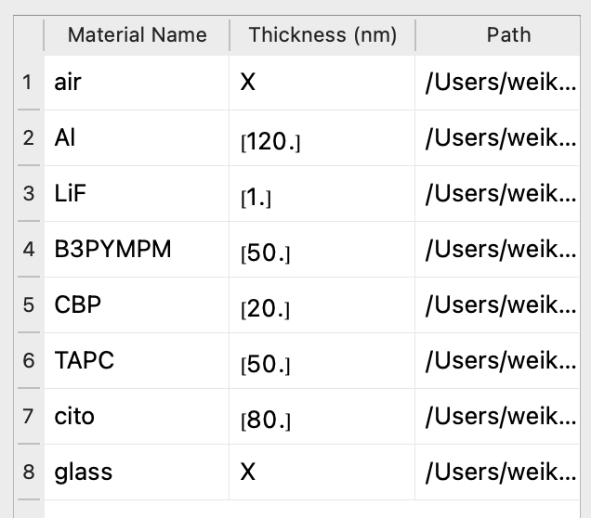
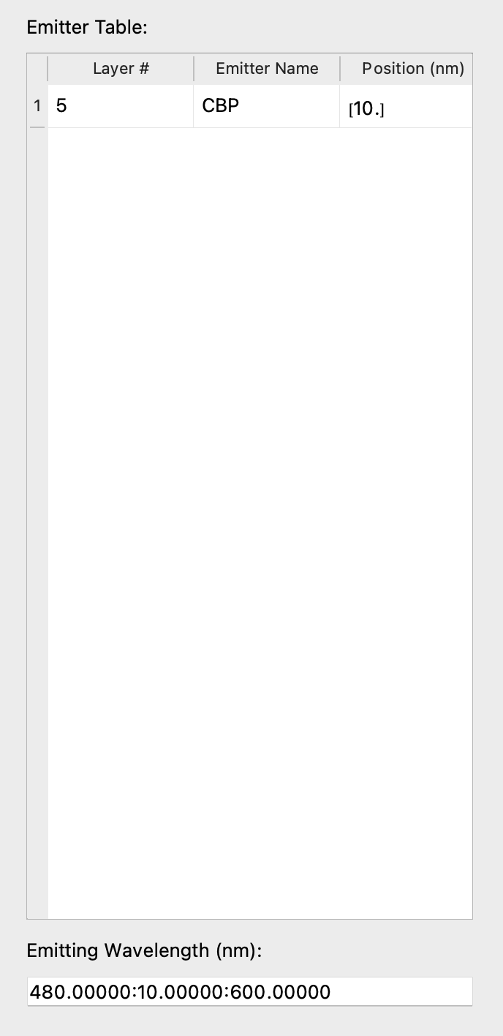
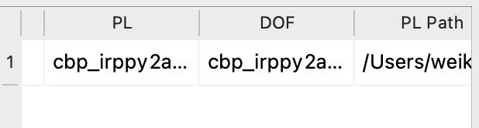
(a) device structure
(b) EML
(c) emitting wavelength

Slide 5
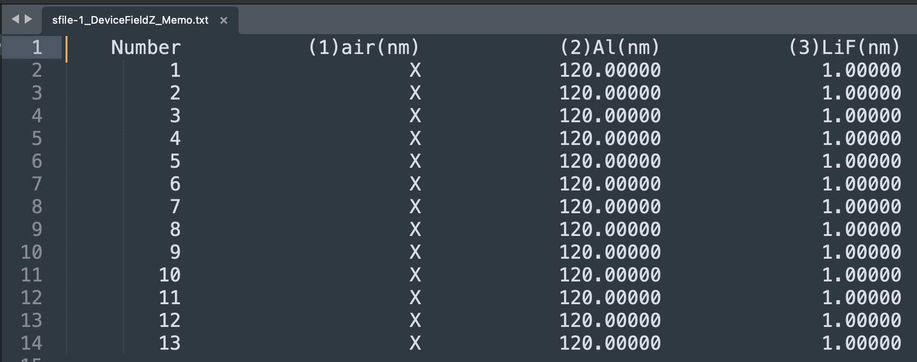
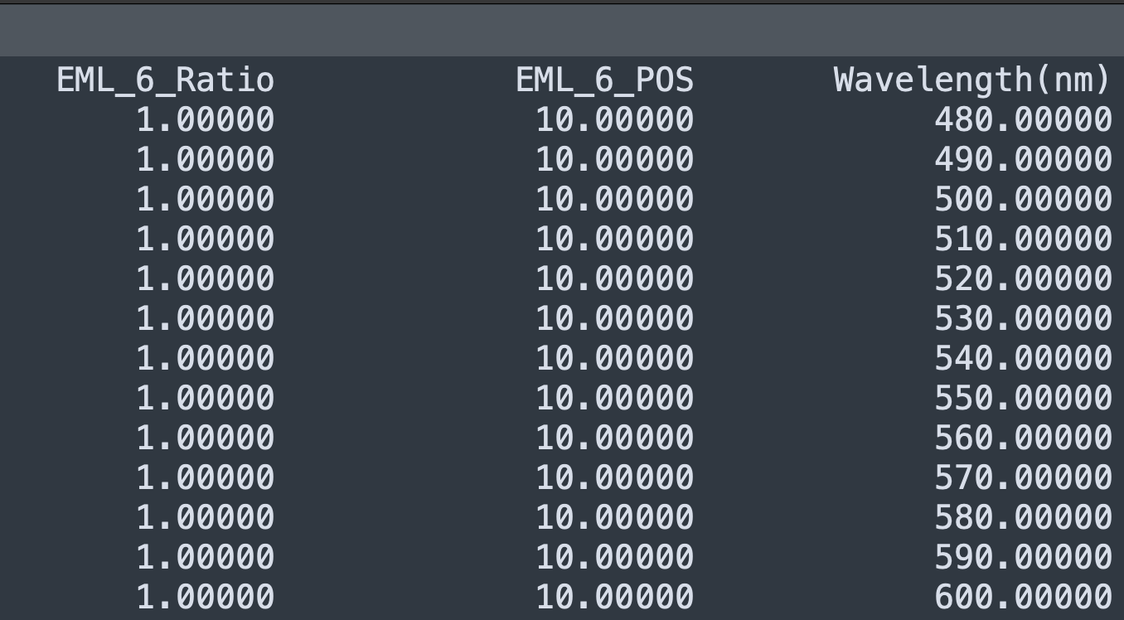

Slide 6
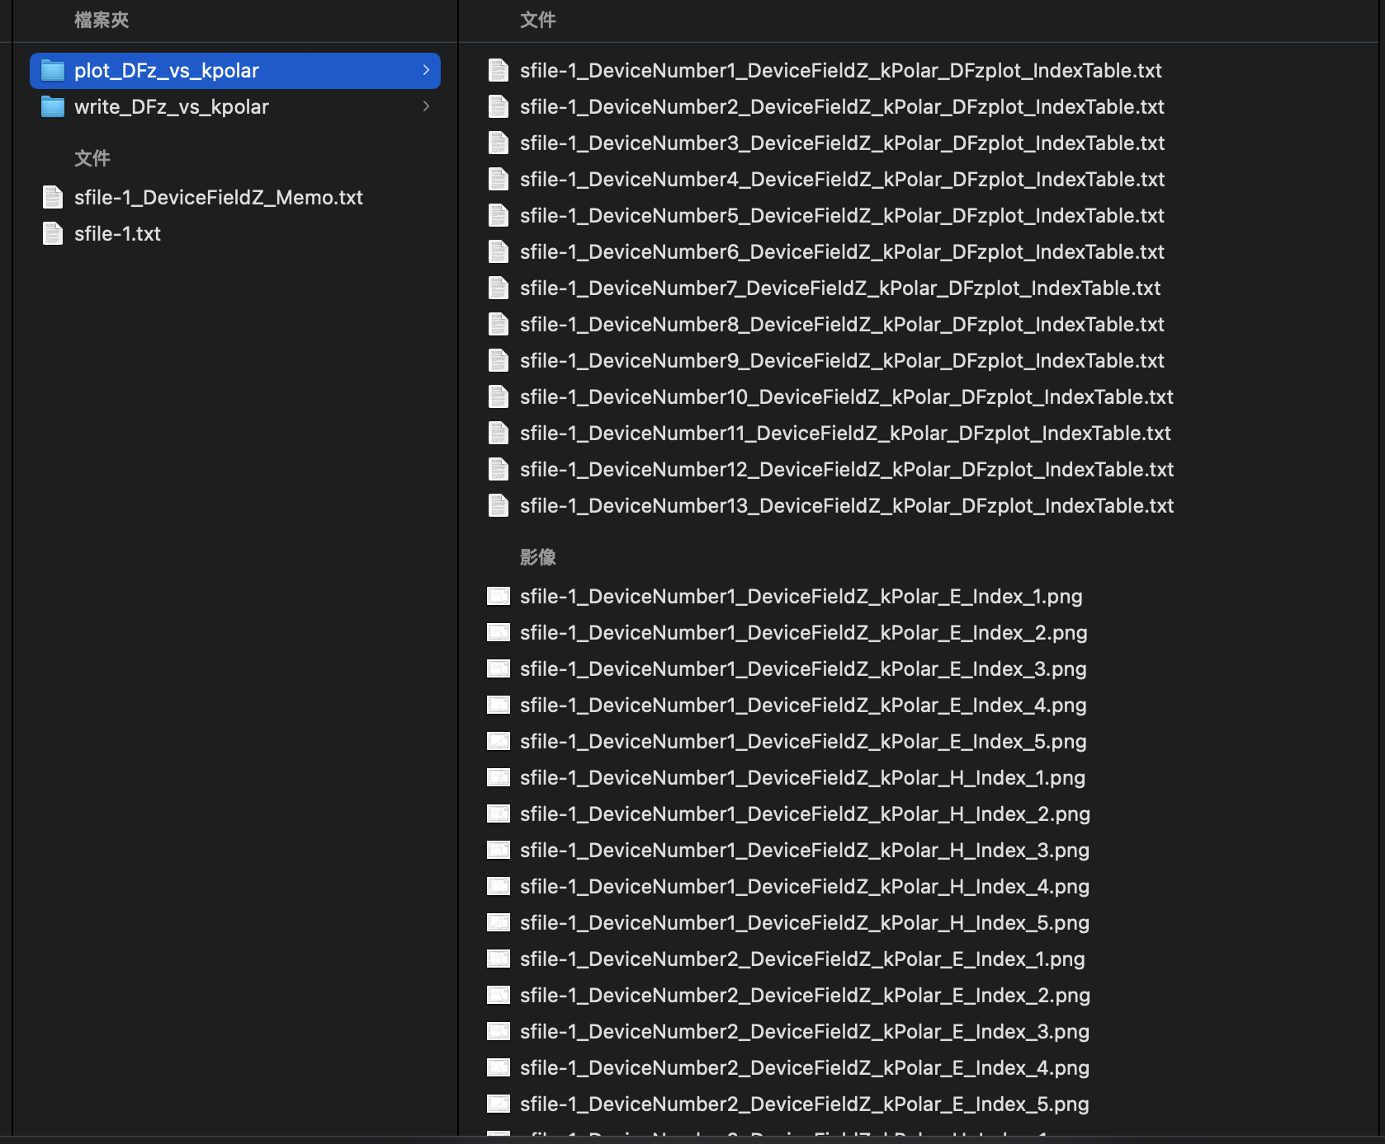
Index table
Device 1
Device 2

Slide 7
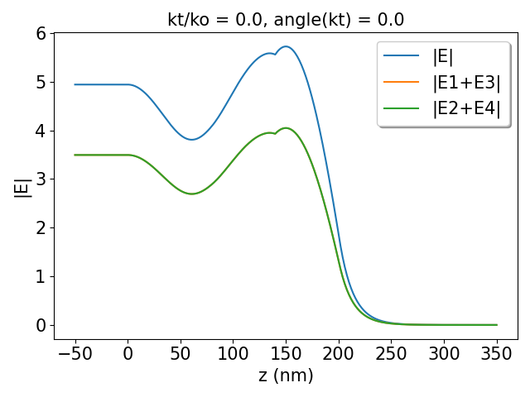
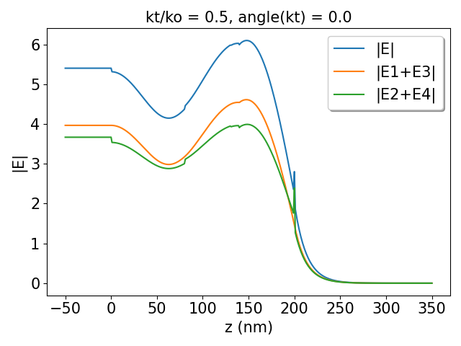
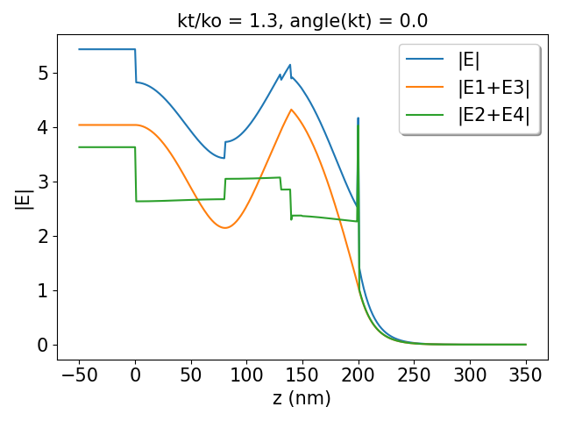
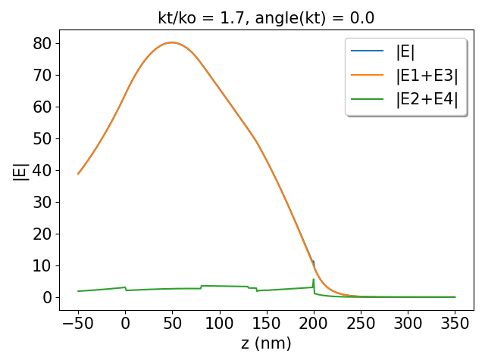
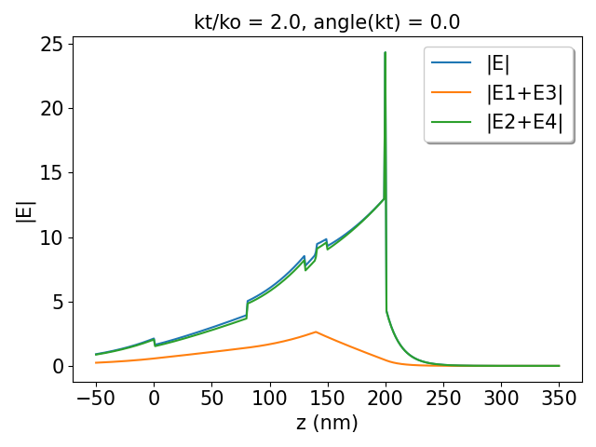
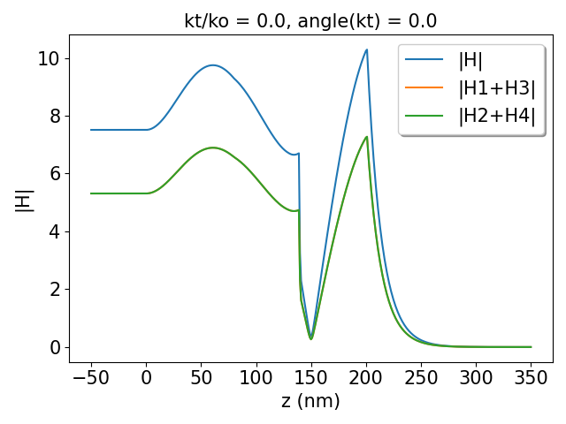
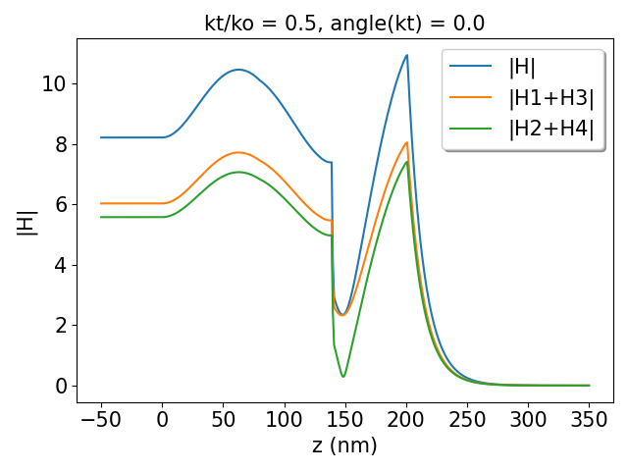
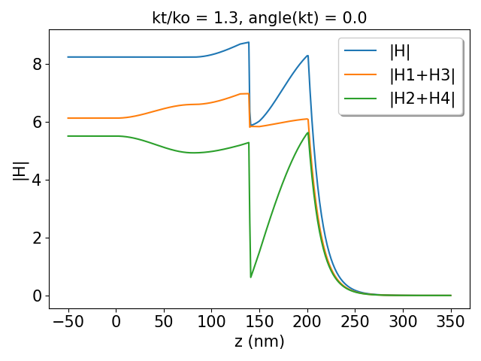
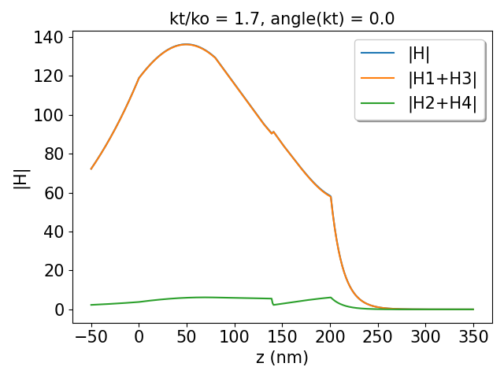
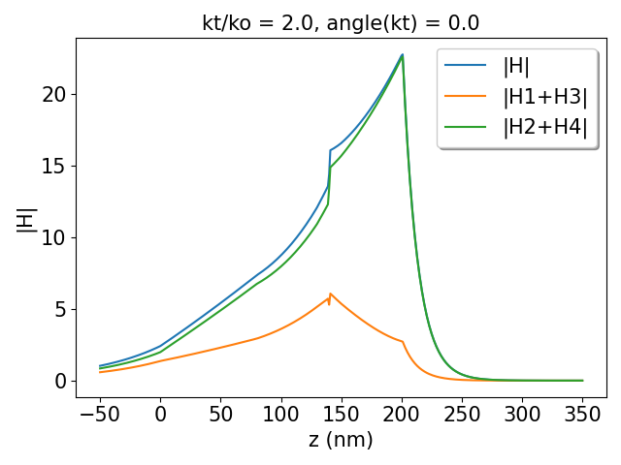
(a)
(b)
(c)
(d)
(e)
(f)
(g)
(h)
(i)
(j)

Slide 8
glass
ITO
TAPC
CBP
Al
B3PYMPM
air

